Slide 1
Central Agency for Public Mobilization & Statistics (CAPMAS) ARAB SPRING CAUSES & ROLE OF NSOs
ABO BAKR ELGENDY
CAPMAS PRESIDENT
Egypt
28/2/2012

Slide 2
Contents
Over view of the Arab Spring.
Causes of the Arab Spring.
The Impact of the Arab Spring on NSOs Role.
CAPMAS and the Arab Spring.
Looking ahead.
2

Slide 3
1- Overview of Arab Spring
The Arab spring is a Pro-democracy uprising currently sweeping the Middle East and North Africa, sparked in Tunisia on 18th of December 2010 , followed by Egypt on January 25th , Libya, Yamane and Syria.
3

Slide 4
1- Overview of Arab Spring Cont
The protests have shared techniques of civil resistance in sustained campaigns involving strikes, demonstrations, marches, and rallies, as well as the use of social media to organize, communicate, and raise awareness in the face of state attempts at repression and Internet
censorship.

Slide 5
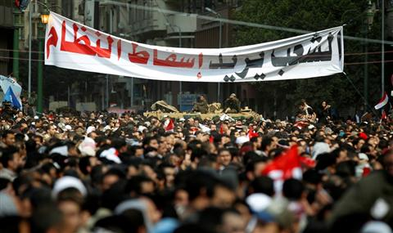
1- Overview of Arab Spring Cont
Demonstrations have faced violent reaction from authorities and anti-demonstrators.
A major slogan of the demonstrators in the Arab world has been ash-shab yurid isqat an-nizam
(” the will of the people is to bring down the regime”).
“الشعب يريد إسقاط النظام”

Slide 6
2- Causes of Arab Spring.
As the economic crisis played a key role factor in triggering the Arab spring, The unrest was primarily about bad governance as it was about the economy.
The slogans used in most revolutions across the Arab world .. they all accused their governments of abandoning it’s people.

Slide 7
2- Causes of Arab Spring. Cont
The lack of good governance is the primary cause of
Corruption.
Lack of social justice.
Exclusion of the society’s minorities
Repression.

Slide 8
3- The Impact of the Arab Spring on NSOs Role.
- Enhancing statistical indicators that measure and monitor good governance become one of the most important role of the NSOs.
- Adopting the global integrated systems for good governance indicators and Information availability, suitable for the region’s cultural demands and priorities.
- Supporting the developmental decisions.

Slide 9
Information availability and Good governance
Democracy
Decentralization
Promoiting competition
Strengthening the citizens role and civil society
Freedom of expression
Good governance
Open / Free society and public interaction
Achieveing transparency.
Fight against corruption
Speed ​​of government action.
Increasing transparency and information availability
Individuals and institutions Participation in decision-making
Accountability

Slide 10
3- The Impact of the Arab Spring on NSOs Role. Cont
NSO’s should focus on.
Measuring Corruption
- Enhancing and developing comprehensive transparent indicators systems.
- Adopt and design corruption and bribe payers indicators tailored to suit society’s needs.

Slide 11
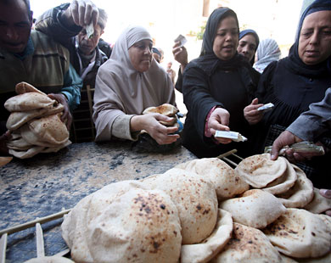
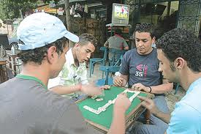
3- The Impact of the Arab Spring on NSOs Role. Cont
Social justice
- Produce statistics for both economic and social phenomena that reflects the society's standard of living (minimum wages, poverty, inflation and unemployment …).
- Focus on disaggregated justice indicators (Gender, geographical areas , slums, ethnic groups ...).

Slide 12
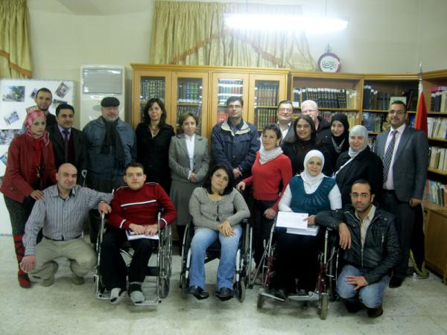
3- The Impact of the Arab Spring on NSOs Role. Cont
Exclusion of the society’s minorities
- Produce statistics for fragile groups in the society (Women, youth, disabled, …)

Slide 13
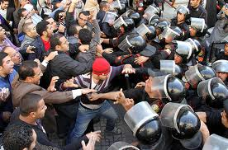
3- The Impact of the Arab Spring on NSOs Role. Cont
Repression
- Provide all needed data- bases for crimes, crisis and victims for national and sub-national levels.

Slide 14
4- CAPMAS and the Arab Spring
CAPMAS played important role during the Egyptian Revolution especially on mobilization & crises management :
Design and calculate special and quick indicators to measure the lag at the main economic sectors to shed light on economic losses.
Provided data about the level and trend of strategic commodities and fuel’s reserves.
Mobilize means of transportation to distribute strategic, essential goods from ports, across the country during the curfew and the first weeks of the revolution.

Slide 15
5- Looking Ahead
Adopt an integrated system for monitoring and evaluation.
Enhancing statistical culture, which plays an important role in bringing the government closer to its citizens and in strengthening the fundamental values of democracy.
Create databases for democracy, human rights and good governance modules .
Institutional reform of the statistical system.
Strengthen NSOs capacity to meet the increasing demands on official statistics.

Slide 16
Thank you

